Slide 1
Blockchain + Smart Contracts Percival Lucena IBM Research
V2.01 29 Oct 15
https://ibm.box.com/BlockExp

Slide 2
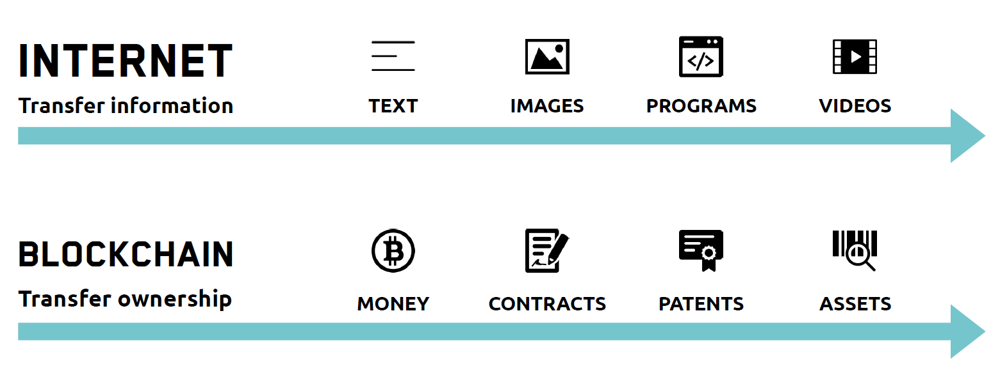
Digital Representations

Slide 3














Enterprise Architecture
Party A’s records
Party A’s records
Party D’s records
Bank records
Party D’s records
Bank records
Shared, replicated, permissioned
Party C’s records
Party B’s records
Auditor records
Party C’s records
Party B’s records
Auditor records
Solution - Consensus, provenance, immutability and finality
Problem - Inefficient, expensive, and vulnerable
Notes:
Ledger - Ledger is THE system of record for a business. Business will have multiple ledgers for multiple business networks in which they participate. Or we can have a shared ledger as demonstrated in the solution. What’s new e here is the SHARED LEDGER – up to this point each participant had their own Ledger. This sharing is the foundation for innovative business solutions.
This introduces an interesting set of technical challenges, including participant identity and privacy & transaction privacy
“BEFORE” picture representing the “status quo” for business networks.
Each participant keeps their own ledger(s) which are updated to represent business transactions as they occur.
This is EXPENSIVE due to duplication of effort and intermediaries adding margin for services.
It is clearly INEFFICIENT, as the business conditions – the contract – is duplicated by every network participant
It is also VULNERABLE because if a central system(e.g. Bank) is compromised due to an incidents this affects the whole business network. Incidents can include fraud, cyber attack or a simple mistake.
The second picture represents the Blockchain architecture. The participants have the ability to share a ledger which is updated every time a transaction occurs through peer to peer replication.
Cryptography is used to ensure that network participants see only the parts of the ledger that are relevant to them, and that transactions are secure, authenticated and verifiable.
Blockchain also allows the contract for asset transfer to be embedded in the transaction database determining the conditions under which the transaction can occur.
Network participants agree how transactions are verified through consensus or similar mechanisms. Government oversight, compliance & audit can be part of the same network.
Participants SAME AS BEFORE – this is not a disintermediation play
CONSENSUS– means all participants agree that a transaction is valid
PROVENANCE– means participants know where the asset came from and how it’s ownership has changed over time
IMMUTABILITY– means no participant can tamper with a transaction once it’s agreed. If a transaction was in error then a NEW transaction must be used to reverse the error, with both visible
FINALITY– means that there is ONE place to determine the ownership of an asset or completion of a transaction. This is the role of the SHARED LEDGER.

Slide 4



Blockchain Value
Saves time | Removes cost | Reduces risk | Increases trust
Reconiliation- Transaction time from days to near instantaneous | Overheads and cost intermediaries | Tampering, fraud & cyber crime | Through shared processes and recordkeeping
Notes:
Other benefits include :
Improve discoverability
When everyone on an exchange can view the same ledger, it is easy to broadcast an intention (or offer) by appending it. For example, in a trading network, all asks and bids would be visible to every network participant.
Automate trusted processes
Unlike a centralized system where only the network operator can create a generalized solution that fits every user’s needs, Blockchain networks allow each participant to create customized solutions using their own proprietary business logic while running on the same common ledger.
Ensure trusted record-keeping
By design, no one party can modify, delete, or even append any record to the ledger without the consensus from others on the network, making the system useful for ensuring the immutability of contracts and other legal documents.

Slide 5
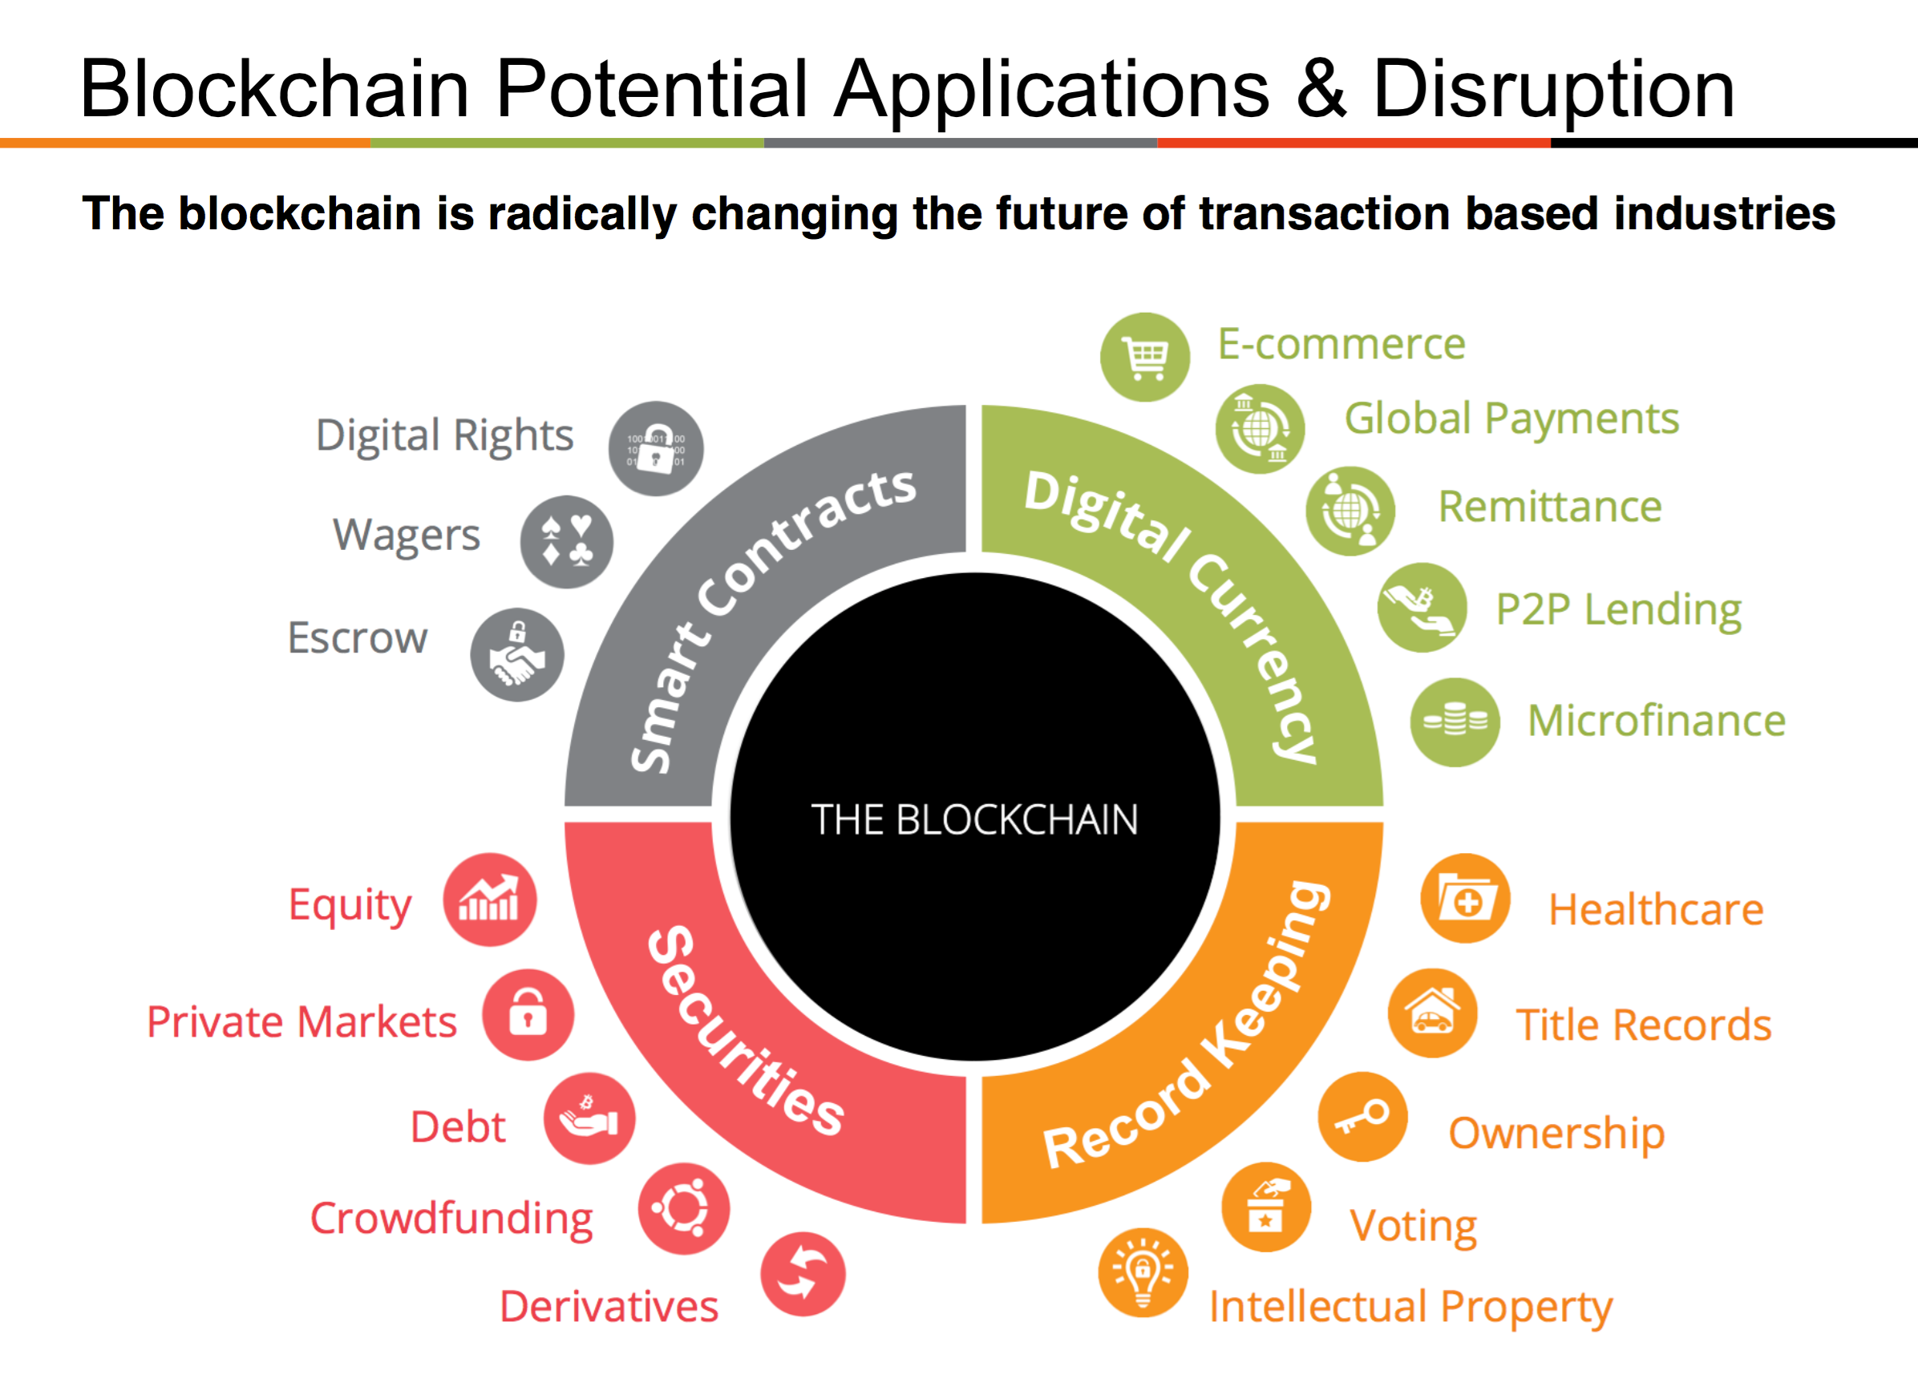
BLOCKCHAIN

Slide 6
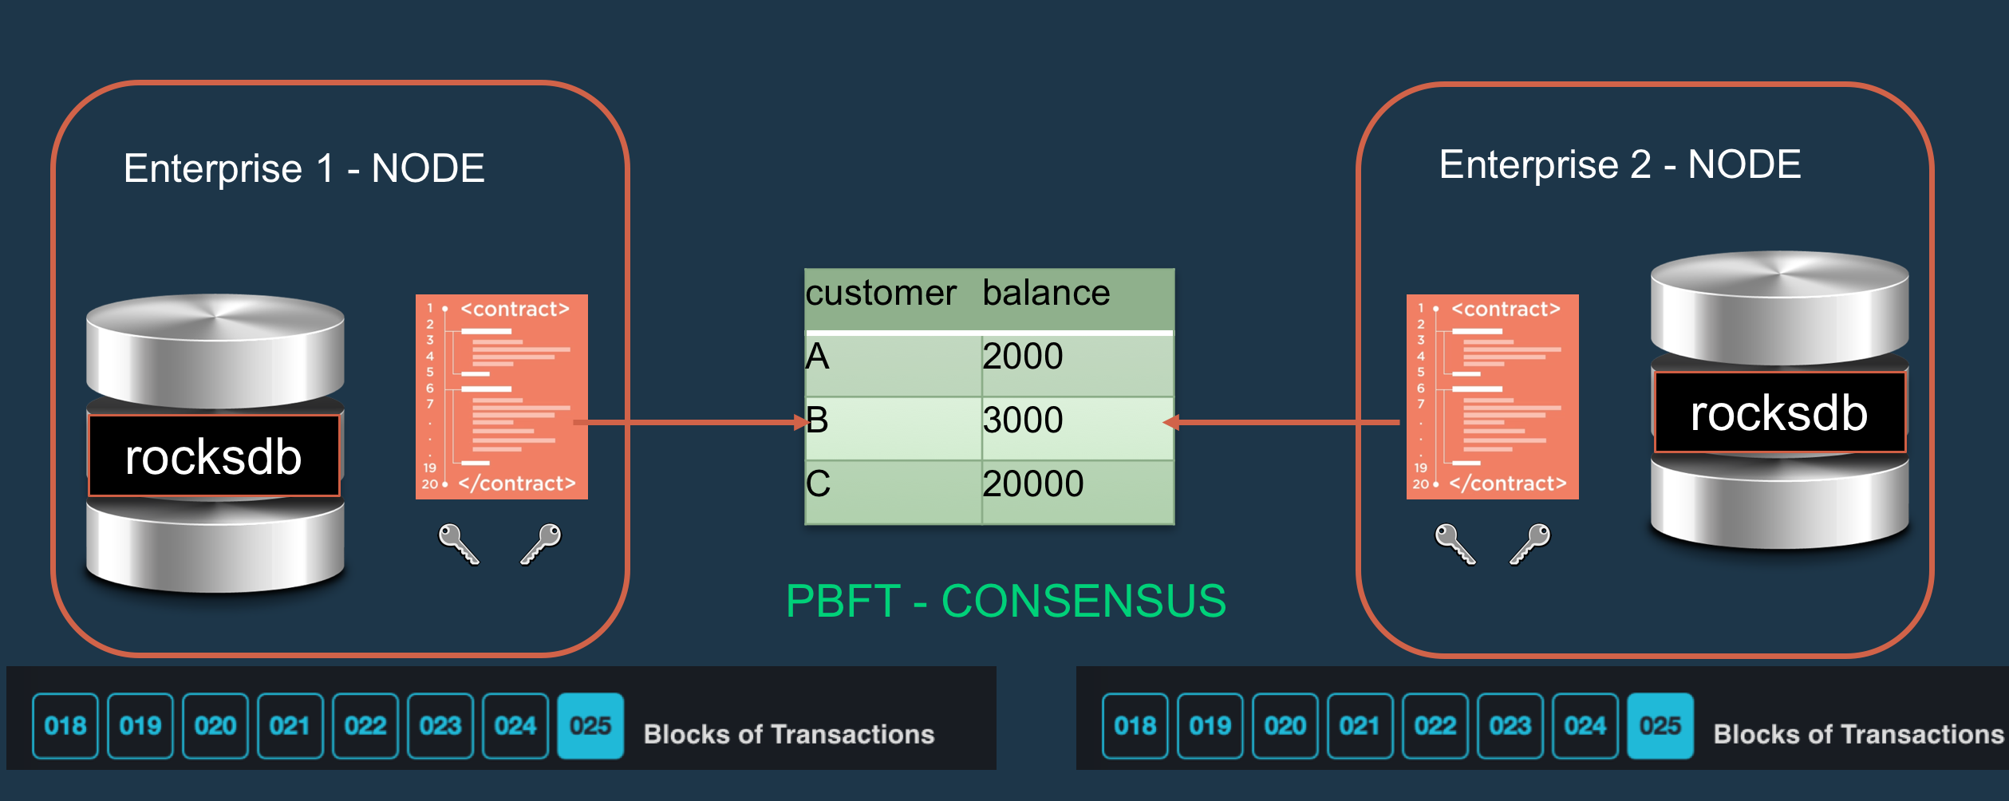
Hyperledger Fabric 0.6

Slide 7
Video
https://www.youtube.com/watch?v=lD9KAnkZUjU

Slide 8



Blockchain Analytics: Compliance
Obligations
Blockchain Rules
Compliance Dashboard
Blockchain Cognitive Compliance Powered by IBM Blockchain
Blockchain Solution: Eveledger Diamonds Tracking
Rule Definition for Obligation
Any diamond from a participating country, should have a Kimberley certificate
Blockchain Datatypes
Blockchain Permissions
Rule Definition
Select data structures relevant for this compliance rule
Diamond Data
Kimberley Certificate
✔
Highlight selected data to permit access
Description: information about diamond properties
Description: Diamond export information including
exporter, importer, certificates, verification, etc.
Sample Attributes:
"origin": { "type": "string" },
"shape": { "type": "string" },
"weight": { "type": "float" },
"length": { "type": "float" },
"width": { "type": "float" },
"depth": { "type": "float" },
"color": { "type": "string" },
Sample Attributes:
"certificateBatchNumber": "1234567",
"creationDate": "2016-11-07T",
"expiryDate": "2017-01-06T12:47:53.265Z",
"exportCountry": "(Mining) ****",
"exportDate": "2016-11-07T12:00:00.000Z",

Slide 9
Blockchain Analytics: Compliance
Obligations
Blockchain Rules
Compliance Dashboard
Blockchain Cognitive Compliance Powered by IBM Blockchain
Blockchain Solution: Eveledger Diamonds Tracking
Rule Definition for Obligation
Any diamond from a participating country, should have a Kimberley certificate
Blockchain Datatypes
Blockchain Permissions
Rule Definition
From the available data structures on the left create the compliance and non-compliance rules
Kimberley Certificate
Compliance Condition
Description: Diamond export information including
exporter, importer, certificates, verification, etc.
When the conditions below is satisified the document on blockchain will be compliant
Available Attributes:
certificateBatchNumber
hasPaperKBCUploaded
creationDate
expiryDate
exportCountry
exportDate
exportCountry
hasPaperKBCUploaded
verifiedBy
verifierDetails
verifyDate
weight
shippedDate
Condition:
ANY:
IF exportCountry in participatingCountries AND hasPaperKBCUploaded is TRUE
IF exportCountry not in participatingCountries
✔
✔
✔
Check against: blockchain ledger blockchain state
✔
Non-compliance Condition
When the condition below is satisified the document on blockchain will be non-compliant

Slide 10
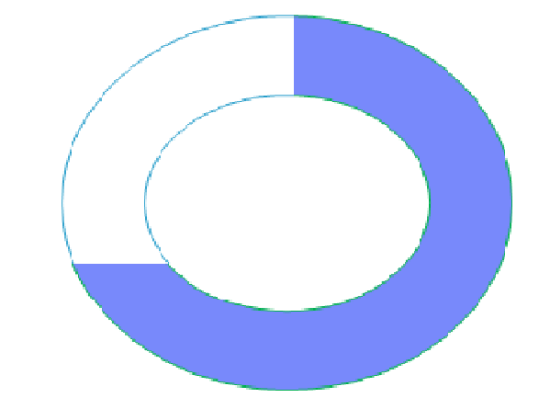
Blockchain Analytics: Compliance
Obligations
Blockchain Rules
Compliance Dashboard
Blockchain Cognitive Compliance Powered by IBM Blockchain
Blockchain Solution: Cognitive Compliance Tracking
Rule execution for obligation
Any diamond from a participating country, should have a Kimberley certificate
87,000 Total Diamond Records
57,000 Records permitted access
44,000 Records compliant
13,023 Records non compliant
Compliance Tracking Progress
Reading …. 48,300
View non
compliant records
Predict non compliant records

Slide 11
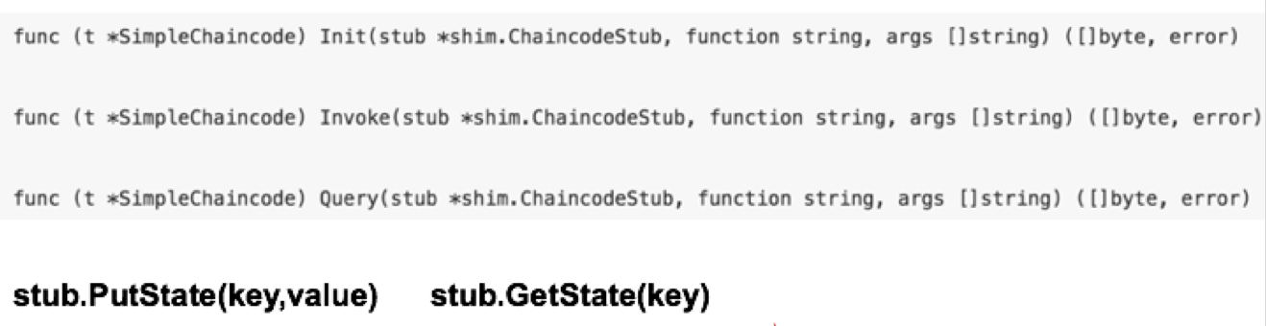
Blockchain Smart Contracts

Slide 12
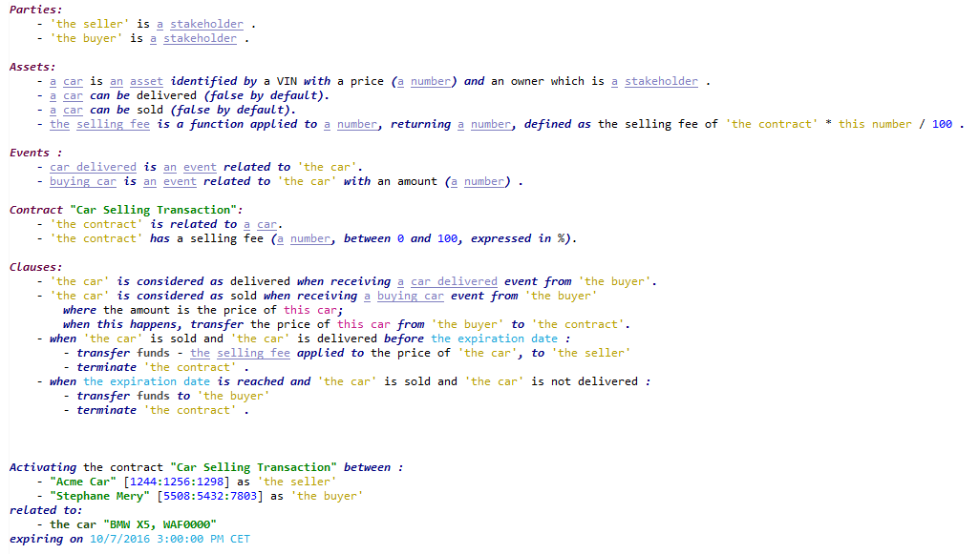
Proposal: A Smart Contract DSL(*) to define Smart Contracts
Define Participants of the contract
Define Assets managed by the Contract. Use a powerful Domain Modeling language
Define Business Events related by the contract which can be brought as transactions in the Blockchain
Clauses of the Contract are really the Business Rules to apply when processing a transaction
(*) Domain Specific Language

